Slide 1

From <code/> to global scale Building a static web app in minutes
John Papa
Notes:
Welcome! Let's start with a story, that many of you are familiar with …

Slide 2
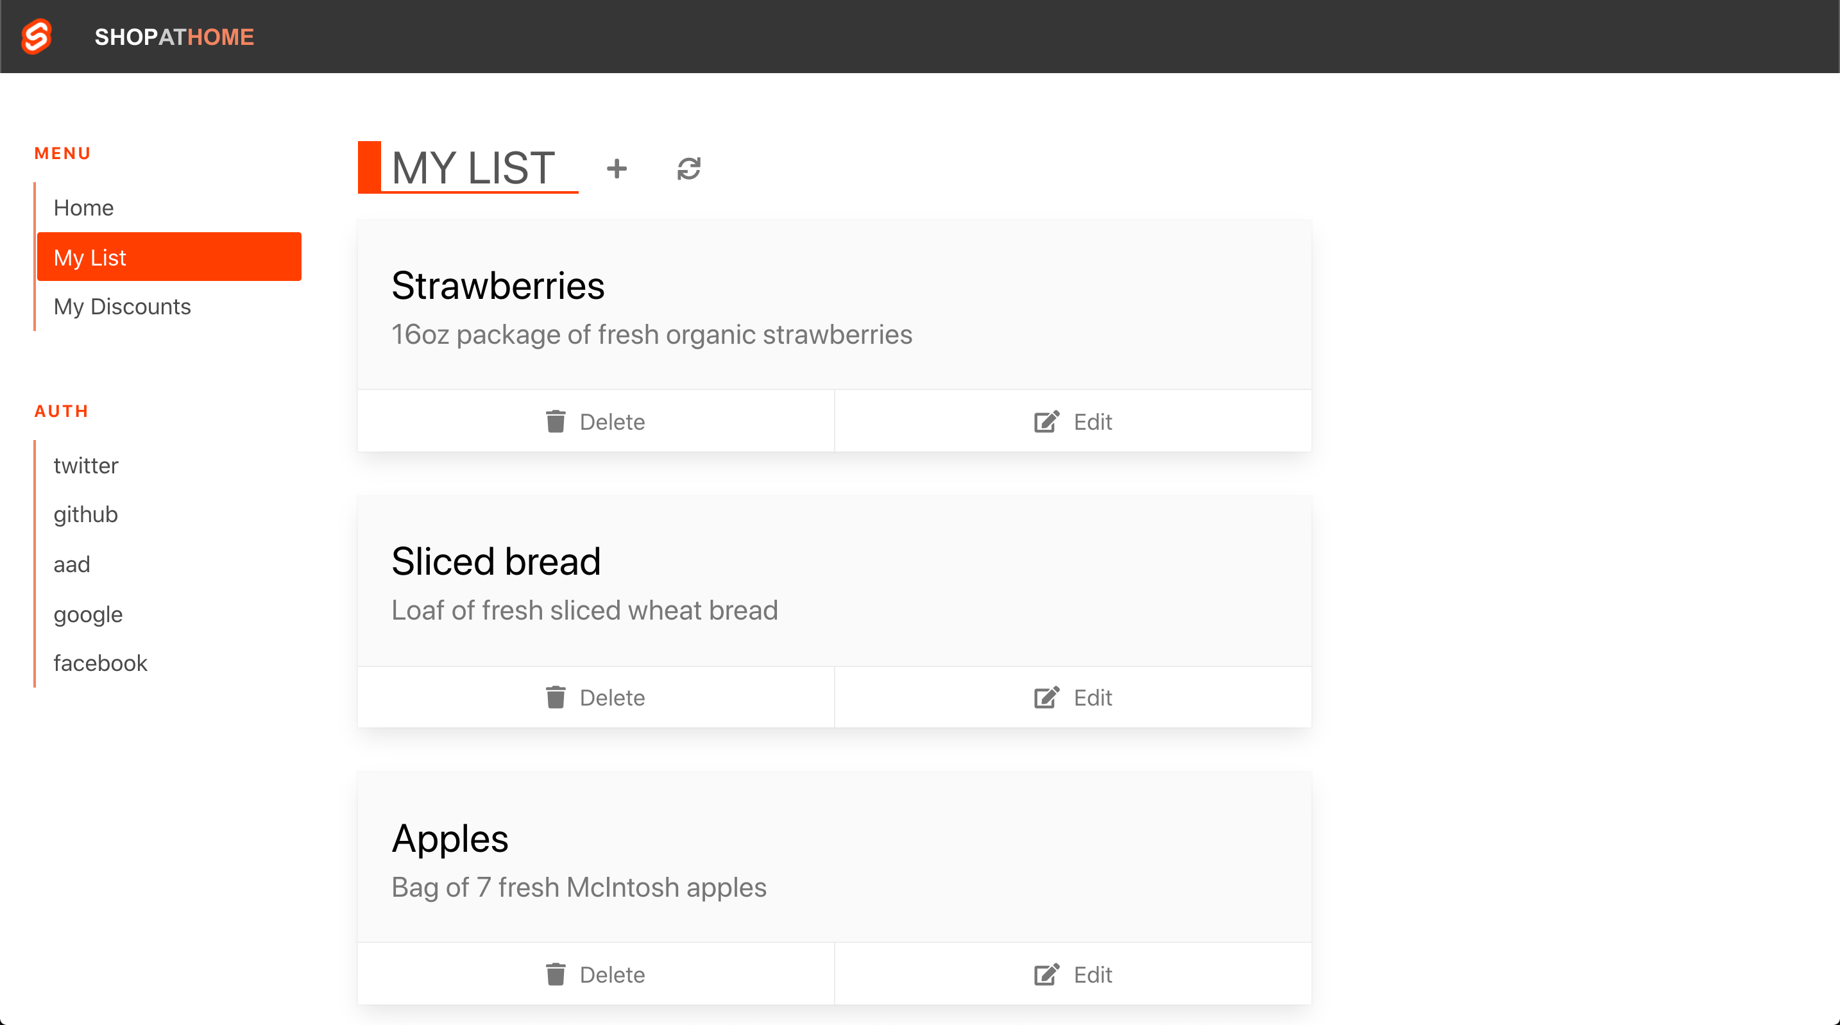



Your code
Notes:
You've built an app. And the app connects people who need groceries with those who can provide them. Millions of people could use this now.
Let’s think about what you need to do to get it to your users …

Slide 3
Your code
Notes:
You wrote your code

Slide 4

Push to GitHub
Notes:
Pushed it to GitHub

Slide 5

CI/CD
Notes:
You intend to setup CI/CD

Slide 6

APIs
Notes:
And you need APIs to get data. Will they be served on another server?

Slide 7

Route requests from your App to API
Notes:
You need your app to route requests to your API, securely

Slide 8
www
SSL and Custom Domains
Notes:
Speaking of security, you definitely want an SSL certificate and a custom domain

Slide 9

Authentication
www
Notes:
Your users must authenticate

Slide 10

Security Roles
www
Notes:
And you might need to define roles for authorization

Slide 11
Global scale
www
Notes:
And ultimately, you need your app to reach everyone around the world --- at global scale

Slide 12
www
Notes:
Wow!

Slide 13
you just want to publish your app!!!
www
Notes:
… you just want to publish your app!!!

Slide 14
Angular
Notes:
Angular

Slide 15
React
Notes:
React

Slide 16
Svelte
Notes:
Svelte

Slide 17
Vue
Notes:
And Vue
These tools have fundamentally changed the way we build web applications. Instead of a server runtime that makes database queries and builds pages dynamically when they are requested, these new JavaScript powered applications run entirely in the browser. We have moved the application responsibilities of the server, entirely into the client.

Slide 18
Client-side build process
Notes:
There’s now a build process required on the client side.

Slide 19
All of your code for your application has to be built before it can be deployed.
$> npm run build
Notes:
All of your code for your application has to be built before it can be deployed.

Slide 20
What you get out of the other end of that build process
$> npm run build
Success!
$>
/build
index.html
main.min.js
main.min.css
Notes:
What you get out of the other end of that build process is just some “static” files. We call them ”Static”, because they don’t change. They don’t require a web server to build them dynamically like with ASP.NET, PHP or JSP.
In fact, we don’t really need much of a web server at all. All we need is to return these files just as they are. This is almost a throwback to a time when the web wasn’t full of dynamic applications rendered by servers. We’re back to just the core components of the web

Slide 21
HTML, CSS, and JavaScript
$> npm run build
Success!
$>
/build
index.html
main.min.js
main.min.css
Notes:
… HTML, CSS, and JavaScript
Traditional web servers don’t handle the build steps these apps require. We need a fundamentally new kind of cloud service for these new applications.

Slide 22
Azure Static Web Apps
From <code/> to global scale
/build
index.html
main.min.js
main.min.css
Building a static web app in minutes
Notes:
Introducing Azure Static Web Apps

Slide 23
From <code/> to global scale Building a static web app in minutes
John Papa
Notes:
Hi, I’m John Papa. Today you’ll learn how to take your code to global scale in minutes with Azure Static Web Apps

Slide 24
Azure Static Web Apps
Notes:
Azure Static Web Apps is a complete platform for building and hosting static web apps

Slide 25
Azure Static Web Apps
build and host static web apps
Notes:
It’s a new Azure Service for building and hosting static web applications,

Slide 26
authentication and authorization
build and host static web apps
authentication and authorization
Notes:
You get authentication and authorization

Slide 27
APIs powered by Azure Functions
build and host static web apps
authentication and authorization
APIs powered by Azure Functions
Notes:
And it features API’s powered by Azure Functions

Slide 28


CI/CD powered by GitHub Actions
build and host static web apps
authentication and authorization
REPO
APIs powered by Azure Functions
app
api
CI/CD powered by GitHub Actions
Notes:
and a CI/CD pipeline powered by GitHub Actions that's automatically setup for you.

Slide 29






So how does this work?
STATIC WEB APPS
REPO
STATIC CONTENT
HTML/JavaScript/CSS
app
PUSH/PR
ACTION
api
API
Azure Functions
Notes:
So how does this work?
You create an Angular, React, Vue, Svelte Static Site generator or even just an index.html page.
If you want an API, you create an “api” folder in your project and add in some Azure Functions endpoints.
You push your code to GitHub, and Azure Static Web Apps creates the GitHub Action to build your project and then deploys it a geo-replicates it to 5 regions immediately.

Slide 30
Demo: Publishing to Azure Static Web Apps
Now let’s see how to publish your app and API, then we’ll add auth
App
API
Auth
Notes:
Now let’s see how to publish your app and API, then we’ll cover auth.

Slide 31
Demo: Publishing to Azure Static Web Apps
We published the app and the API, now let’s configure auth
App
API
Auth
Notes:
And our journey begins with your code in GitHub …
[Now switch to the demo to build the SWA in the portal for your App and API]

Slide 32
Demo: Publishing to Azure Static Web Apps
We published the app and the API, now let’s configure auth
App
API
Auth
Notes:
We published the app by pushing to GitHub, which triggered the action to build and deploy it to Azure Static Web Apps. We gained global availability and an SSL cert for our custom domain. Then we added made a new branch, added a fallback route, and modified our workflow for our API.
We created a Pull Request which triggered the action to build and deploy to a staging URL!

Slide 33
Demo: Publishing to Azure Static Web Apps
We took control of our routes by allowing some auth providers and blocking others
App
API
Auth
Notes:
We took control of our routes by allowing some auth providers and blocking others … While guarding some routes for our APIs to specific authorization roles.
[Now switch to the demo to add Authentication and Authorization]

Slide 34
Notes:
Azure Static Web Apps is built for the client-side it gives us a chance to focus on other things besides the server.

Slide 35
And all of this comes together in one easy to use service
Notes:
And all of this comes together in one easy to use service

Slide 36
Azure Static Web Apps
Single unified workflow with GitHub Actions
Serverless APIs powered by Azure Functions
Integrated Auth with flexible roles and access
Notes:
Single unified workflow based on GitHub actions from source code to cloud
Easy to add serverless APIs powered by Azure Functions to extend your app
Integrated Auth with flexible role and access definitions

Slide 37
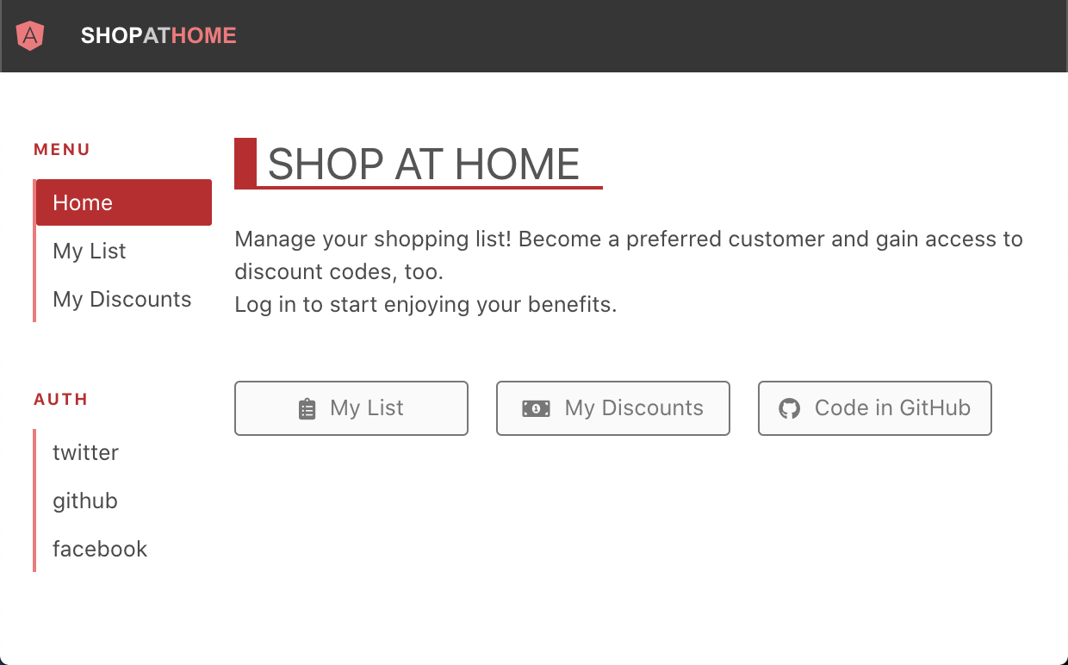
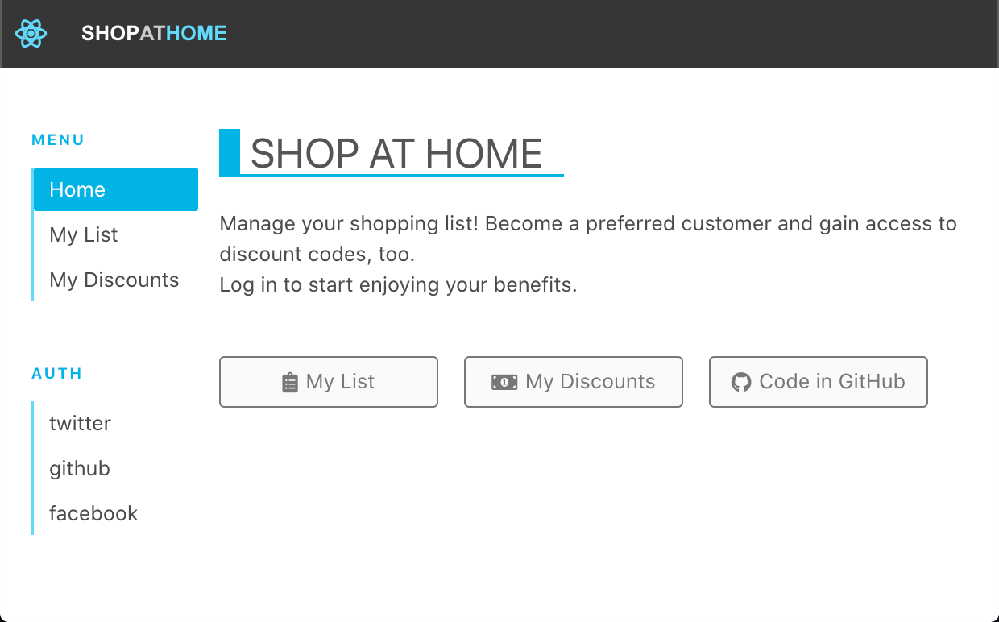
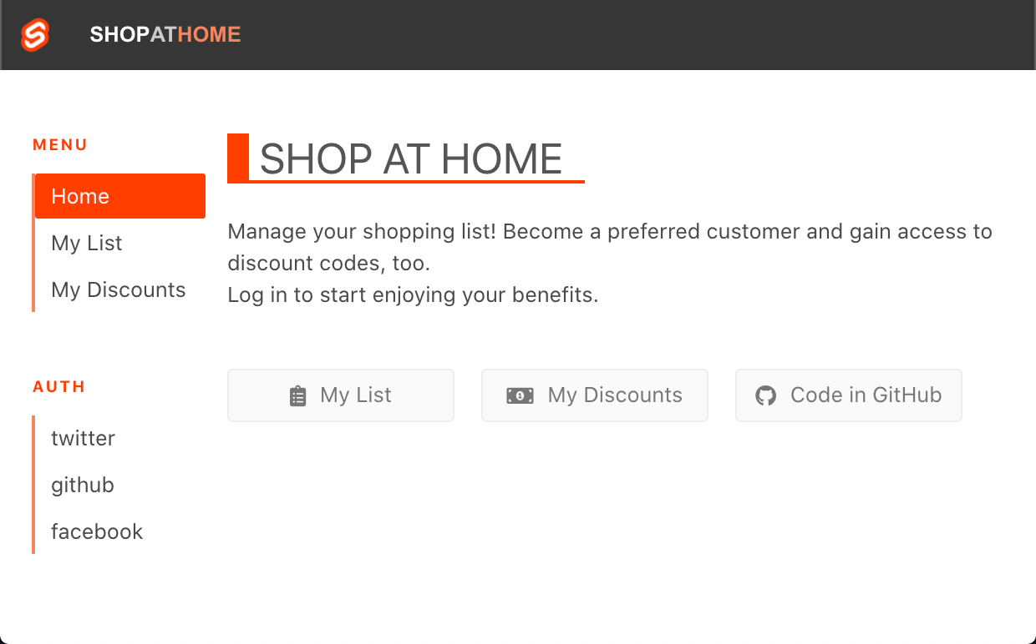
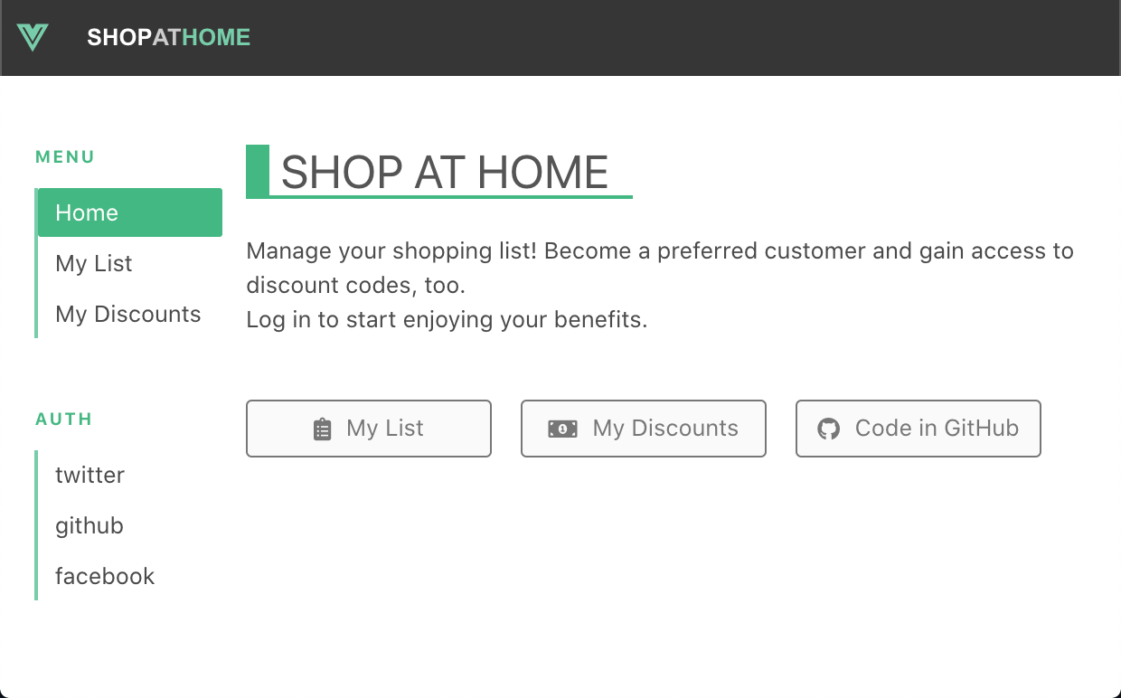
Static Web Apps resources
Microsoft Docs
aka.ms/swadocs
Notes:
You can learn more and try it yourself

Slide 38
Static Web Apps resources
Microsoft Docs
aka.ms/swadocs
Microsoft Learn
Publish Angular, React, Svelte, or Vue aka.ms/swaframeworks
Publish Gatsby
aka.ms/staticsitegen
Notes:
Using our documentation

Slide 39
Static Web Apps resources
Microsoft Docs
aka.ms/swadocs
Microsoft Learn
Publish Angular, React, Svelte, or Vue aka.ms/swaframeworks
Publish Gatsby
aka.ms/staticsitegen
Notes:
And learn to publish your own web apps through hands-on learning, with Microsoft Learn

Slide 40
Static Web Apps resources
Microsoft Docs
aka.ms/swadocs
Microsoft Learn
Publish Angular, React, Svelte, or Vue aka.ms/swaframeworks
Publish Gatsby
aka.ms/staticsitegen
Notes:
Using your favorite JavaScript library with Azure Static Web Apps.
You can build and deploy apps that are fast, secure and reach global scale with azure static web apps.

